Slide 1



Employee Referrals Made Easy
powered by

Slide 2
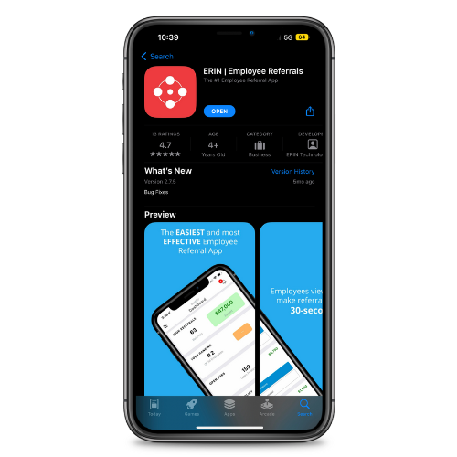
Simply visit the app store, click "install," and follow the prompts.
Download and Install the App

Slide 3
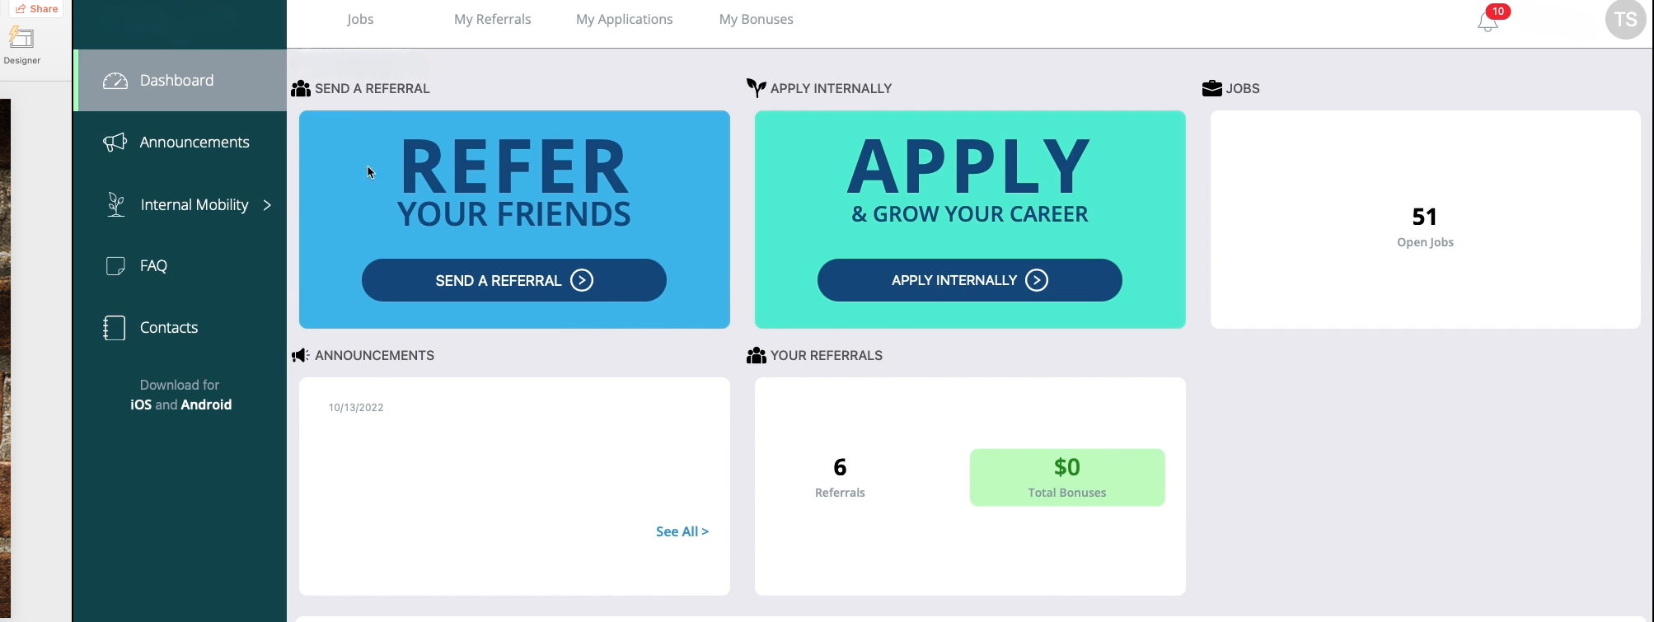
Sign in using the app or use the online platform. View jobs, referrals, and bonuses from both sources.
Online Platform

Slide 4
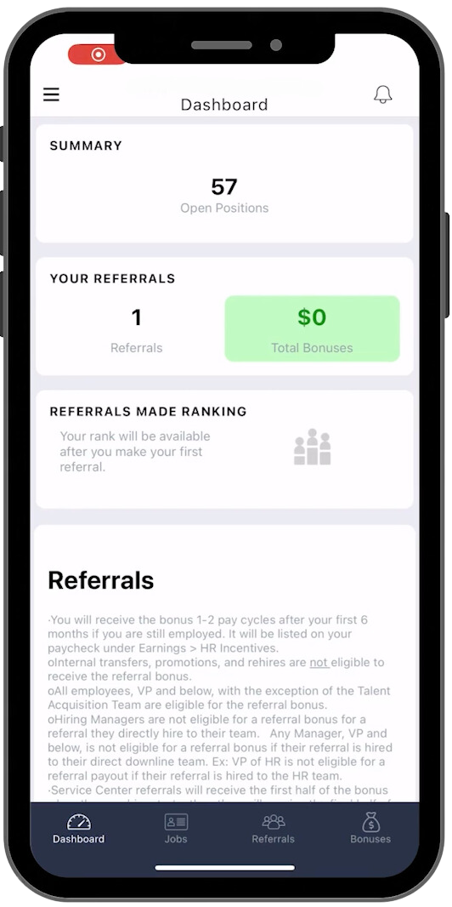
The Dashboard is the starting point for your app experience. From here, you can access all your referrals, bonuses, and your company's referral policy.
The Dashboard

Slide 5
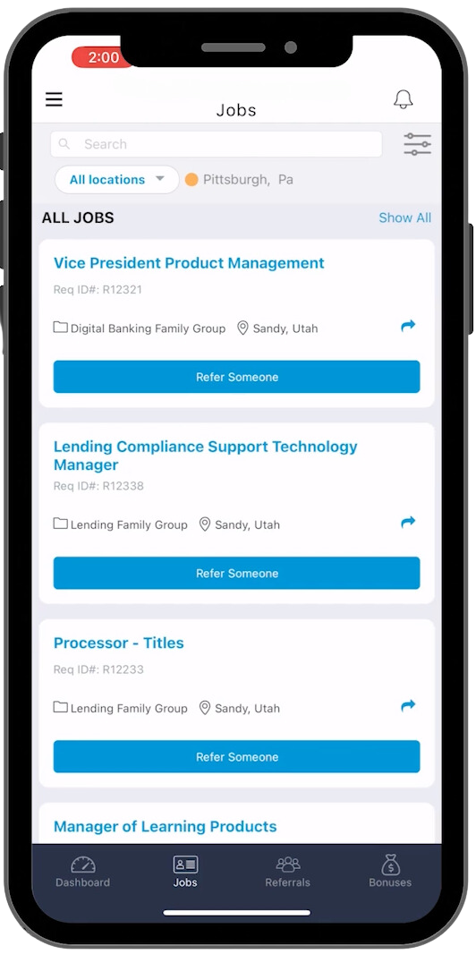
Preview the jobs that your company is looking to fill. Select the best fitting jobs to refer to friends and family.
Jobs View

Slide 6
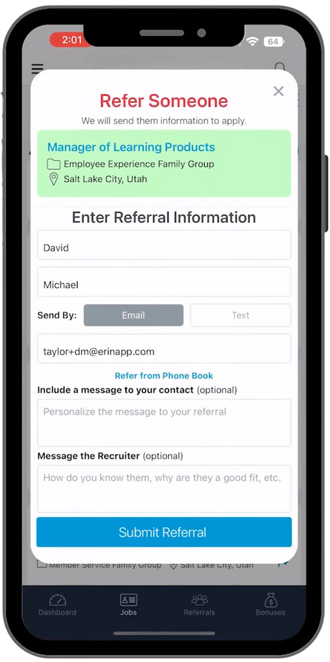
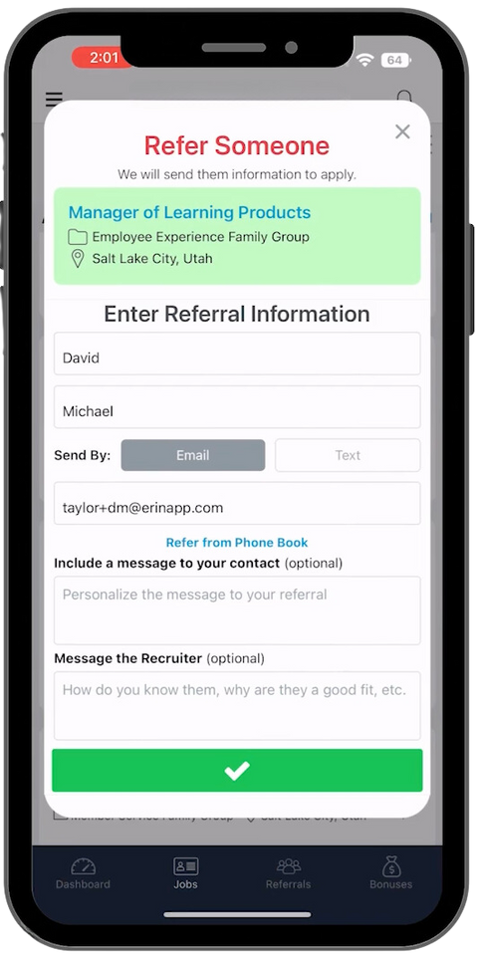
Type in their information and submit.
Refer
Someone

Slide 7
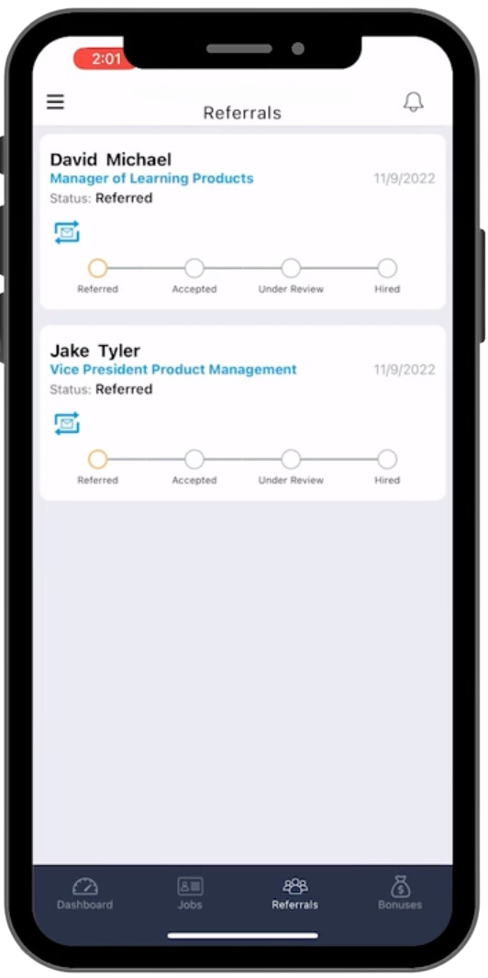
Track your referral progress to see if your referral accepted your invitation. Follow their journey through the hiring process.
Referral Statuses

Slide 8
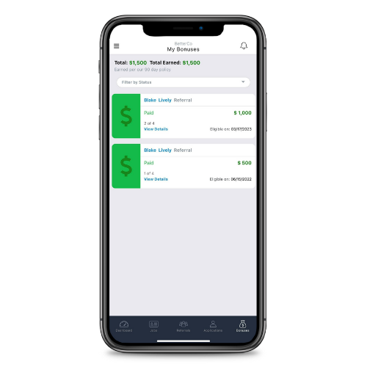
Track your bonuses. View the details of your bonus to find more information about the candidate statuses.
Bonuses

Slide 9
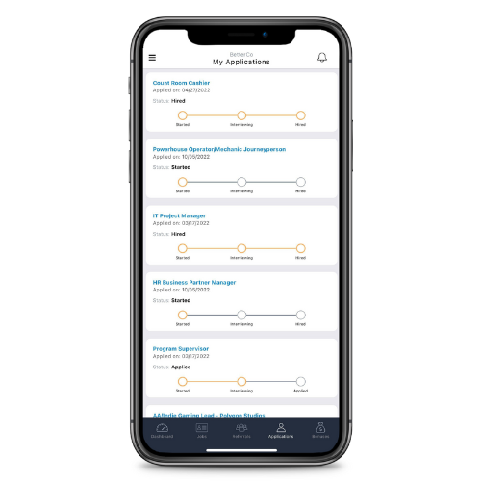
Upward movement in the company at the touch of a button.
Internal Mobility

Slide 10

Go to
[INSERT YOUR COMPANYS URL]
to get started!
For more information, go to
https://support.erinapp.com/knowledge/employee-features

